Slide 1
Selenium WebDriver
Amit Kumar

Slide 2
Agenda
“Selenium automates browsers. That's it! What you do with that power is entirely up to you.”
Introduction to Selenium WebDriver
Java Refresher
Introduction to Maven
Selenium IDE
Selenium WebDriver
Selenium Grid
JUnit vs. TestNg
Frameworks

Slide 3
History
According to SeleniumHQ, the history of Selenium started in 2004 at Thoughtworks with Jason Huggins building the core mode as JavaScript Test Runner. He built the core mode because he did not want to manually step through the same test after every change. Therefore, Jason developed a JavaScript library that permitted him to run test repeatedly against multiple browsers such as Firefox, Google, and Internet Explorer. That library eventually became Selenium Core, which underlies all the functionality of Selenium Remote Control (RC) and Selenium IDE. Selenium RC was ground-breaking because no other product allowed you to control a browser from a language of your choice.
While Selenium was a tremendous tool, it wasn’t without its drawbacks. Because of its Javascript based automation engine and the security limitations browsers apply to Javascript, different things became impossible to do. To make things worse, webapps became more and more powerful over time, using all sorts of special features new browsers provide and making these restrictions more and more painful.
In 2006 an engineer at Google named Simon Stewart started working on a project he called WebDriver. Google had long been a heavy user of Selenium, but testers had to work around the limitations of the product. Simon wanted a testing tool that spoke directly to the browser using the ‘native’ method for the browser and operating system, thus avoiding the restrictions of a sandboxed Javascript environment. The WebDriver project began with the aim to solve the Selenium’ pain-points.
Then came 2008 which led to the merger of Selenium and WebDriver into Selenium 2 a.k.a Selenium WebDriver. Selenium had massive community and commercial support, but WebDriver was clearly the tool of the future. The joining of the two tools provided a common set of features for all users and brought some of the brightest minds in test automation under one roof. Why did the projects merge? In Simon’s words, partly because WebDriver addresses some shortcomings in selenium (by being able to bypass the JS sandbox, for example. And we’ve got a gorgeous API), partly because selenium addresses some shortcomings in WebDriver (such as supporting a broader range of browsers) and partly because the main selenium contributors and I felt that it was the best way to offer users the best possible framework. Selenium 2 got released in 2011.

Slide 4













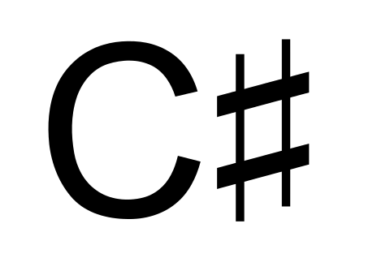





What is Selenium?
Selenium is a suite of tools to automate web browsers across many platforms.
Selenium...
runs in many browsers and operating systems
can be controlled by many programming languages and testing frameworks.

Slide 5




Components of Selenium
Selenium IDE is a Firefox add-on that makes it easy to record and playback tests in Firefox 2+.
You can even use it to generate code to run the tests with Selenium Remote Control.
Selenium Remote Control is a client/server system that allows you to control web browsers locally
or on other computers, using almost any programming language and testing framework.
Selenium WebDriver can drive a browser natively either locally or on remote machines.
Selenium Grid takes Selenium Remote Control to another level by running tests on many servers at
the same time, cutting down on the time it takes to test multiple browsers or operating systems.

Slide 6
Before we begin…
A Java Refresher:
Object Oriented Programming
Object (Data & Logic)
Class (Variables & Methods)
Encapsulation (access modifiers)
Inheritance (single, multi-level, hierarchical, hybrid)
Polymorphism (overloading & overriding)
Abstraction (abstract class & interface)
Learning the language:
Packages
Data Types
Non-access modifiers
Operators
Control Structures
I/O
Collections (List – ordered collection, Set – unordered collection, Map – {key,value})
File Handling
Exception Handling

Slide 7
Before we begin…
Introduction to Maven:
Maven is a project management and comprehension tool that provides developers a complete build lifecycle framework. Maven provides developers ways to manage the following −
Builds
Documentation
Reporting
Dependencies
SCMs
Releases
Distribution
Mailing list
Using Maven for dependency management:
Creating & Configuring a Maven project
Setting up the Maven project for Selenium

Slide 8
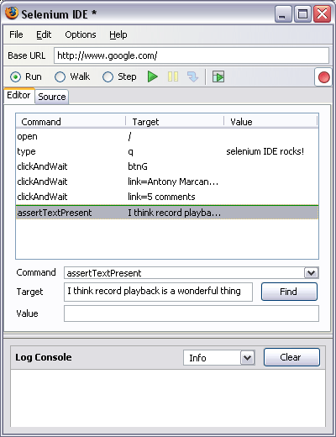
Selenium IDE The Firefox extension for Selenium
Selenium IDE is an integrated development environment for Selenium scripts. It is implemented as a Firefox extension, and allows you to record, edit, and debug tests. Selenium IDE includes the entire Selenium Core, allowing you to easily and quickly record and play back tests in the actual environment that they will run in.
Let’s get rolling!
Downloading & installing Selenium IDE
Selenium IDE user interface
Record & Playback
“Selenese”
Managing Test Cases & Test Suites
Debug & set breakpoints
Export Selenium code from Selenium IDE
user-extensions.js
Rollup
UI Map
Plugins/extensions

Slide 9
Selenium WebDriver
The starting point for testing all web applications begins with a browser. Selenium WebDriver provides support for all major browsers such as Firefox, Google Chrome, Internet Explorer, Safari and Opera. Calls are directed to the browser by using the browser’s native support for automation. Actions are performed on WebElements through WebDriver.
WebElements are your buttons, text boxes, checkboxes, drop down menus, radio buttons, hyperlinks etc.
The building block of Selenium WebDriver is locating a WebElement and performing an action on the WebElement.
Before we begin, let’s create a Java project and configure it for Selenium WebDriver.

Slide 10
Writing code in WebDriver
//WebDriver Packages and Classes
import org.openqa.selenium.WebDriver;
import org.openqa.selenium.firefox.FirefoxDriver;
//WebDriver Object and Methods
//instantiating a Firefox driver object
WebDriver driver = new FirefoxDriver();
//Launch the webapp in the browser
driver.get(“<webapp url>”);
//Find and Perform Actions on WebElements
WebElement element = driver.findElement
(By.locatorType(“<element id>”));
element.click();

Slide 11
WebDriver basic commands
driver.
get(“url”) – load the web application
getTitle() – returns the title of the current page as shown in the browser’s title bar
getCurrentUrl() – returns the url of the current page as shown in the browser’s address bar
getPageSource() – fetches the page source
close() – closes the active browser window associated with the WebDriver
quit() – closes all the browser associated with the WebDriver, i.e. shuts down WebDriver
findElement(By locator) – locates & returns the first WebElement matching the specified locator
findElements(By locator) – locates & returns all WebElements matching the specified locator

Slide 12
Browser Navigations
driver.navigate().
to(”url”) – loads a new web page
forward() – go forward in the browser
back() – go back in the browser
refresh() – refresh the browser
driver.manage().window()
.maximize() – Maximize browser window
.setPosition() – Move the browser window
.getPosition() – Get the browser position
.setSize() – Resize the browser window
.getSize() – Returns the current browser window size
.fullscreen() – Switch to fullscreen mode

Slide 13
Element Locators
By.
className <button class=“button0” id=“login” type=“submit”>
cssSelector input#username
id <input id=“username” name=“name” type=“text”>
linkText <a href=“/login”>User Login</a>
name <input id=“username” name=“name” type=“text”>
partialLinkText <a href=“/login”>User Login</a>
tagName <input id=“username” name=“name” type=“text”>
xpath
→Absolute xpath (/) html/body/input
→Relative xpath (//) //input[@id=‘username’]

Slide 14
XPath Syntax
Expression | Description
nodename | Selects all nodes with the name "nodename"
/ | Selects from the root node
// | Selects nodes in the document from the current node that match the selection no matter where they are
. | Selects the current node
.. | Selects the parent of the current node
@ | Selects attributes
Wildcard | Description
* | Matches any element node
@* | Matches any attribute node
node() | Matches any node of any kind
By using the | operator in an XPath expression you can select several paths.

Slide 15
XPath Predicates
Predicates are used to find a specific node or a node that contains a specific value. Predicates are always embedded in square brackets.
Path Expression | Result
/bookstore/book[1] | Selects the first book element that is the child of the bookstore element.
/bookstore/book[last()] | Selects the last book element that is the child of the bookstore element
/bookstore/book[last()-1] | Selects the last but one book element that is the child of the bookstore element
/bookstore/book[position()<3] | Selects the first two book elements that are children of the bookstore element
//title[@lang] | Selects all the title elements that have an attribute named lang
//title[@lang='en'] | Selects all the title elements that have a "lang" attribute with a value of "en"
/bookstore/book[price>35.00] | Selects all the book elements of the bookstore element that have a price element with a value greater than 35.00
/bookstore/book[price>35.00]/title | Selects all the title elements of the book elements of the bookstore element that have a price element with a value greater than 35.00
<bookstore> <book> <title lang="en">Harry Potter</title> <price>29.99</price> </book> <book> <title lang="en">Learning XML</title> <price>39.95</price> </book> </bookstore>

Slide 16
XPath Axes
An axis defines a node-set relative to the current node. (axisname::node[predicate])
AxisName | Result
ancestor | Selects all ancestors (parent, grandparent, etc.) of the current node
ancestor-or-self | Selects all ancestors (parent, grandparent, etc.) of the current node and the current node itself
attribute | Selects all attributes of the current node
child | Selects all children of the current node
descendant | Selects all descendants (children, grandchildren, etc.) of the current node
descendant-or-self | Selects all descendants (children, grandchildren, etc.) of the current node and the current node itself
following | Selects everything in the document after the closing tag of the current node
following-sibling | Selects all siblings after the current node
namespace | Selects all namespace nodes of the current node
parent | Selects the parent of the current node
preceding | Selects all nodes that appear before the current node in the document, except ancestors, attribute nodes and namespace nodes
preceding-sibling | Selects all siblings before the current node
self | Selects the current node

Slide 17
XPath Axes
Example | Result
child::node1 | Selects all node1 nodes that are children of the current node
attribute::att1 | Selects the att1 attribute of the current node
child::* | Selects all element children of the current node
attribute::* | Selects all attributes of the current node
child::text() | Selects all text node children of the current node
child::node() | Selects all children of the current node
descendant::node1 | Selects all node1 descendants of the current node
ancestor::node1 | Selects all node1 ancestors of the current node
ancestor-or-self::node1 | Selects all node1 ancestors of the current node - and the current as well if it is a node1 node
child::*/child::node1 | Selects all node1 grandchildren of the current node

Slide 18
XPath Operators
Below is a list of the operators that can be used in XPath expressions:
Operator | Description | Example
| | Computes two node-sets | //book | //cd
+ | Addition | 6 + 4
- | Subtraction | 6 - 4
* | Multiplication | 6 * 4
div | Division | 8 div 4
= | Equal | price=9.80
!= | Not equal | price!=9.80
< | Less than | price<9.80
<= | Less than or equal to | price<=9.80
> | Greater than | price>9.80
>= | Greater than or equal to | price>=9.80
or | or | price=9.80 or price=9.70
and | and | price>9.00 and price<9.90
mod | Modulus (division remainder) | 5 mod 2

Slide 19
More XPath functions
contains() - //div[contains(@id,’button’)]
starts-with() - //div[starts-with(@id,’but’)]
ends-with() - //div[ends-with(@id,’ton’)]
text() - //a[text()=‘welcome’]

Slide 20
CSS Locators
ID - # e.g. input#username
Class - . e.g. input.textfield
Attribute e.g. input[type=‘submit’]
Match a prefix e.g. input[type^=‘sub’]
Match a suffix e.g. input[type$=’mit’]
Match a sub string e.g. input[type*=’ubm’]
Inner text e.g. a:contains(‘Sign In’), div:contains(‘^abc$’)

Slide 21
More jQuery selectors for CSS
div:first – first div element
div:last – last div element
ul li:first – first li element under first ul element
ul li:first-child – first li element of every ul element
ul li:last-child – last li element of every ul element
tr:even– all even tr elements
tr:odd – all odd tr elements
nth-child(n)
div:parent()
div:parents()
div:parentsUntil(input)
div:children()

Slide 22
Using Patterns in Locators
abc] | A single character of: a, b, or c
[^abc] | Any single character except: a, b, or c
[a-z] | Any single character in the range a-z
[a-zA-Z] | Any single character in the range a-z or A-Z
^ | Start of line
$ | End of line
\A | Start of string
\z | End of string
(...) | Capture everything enclosed
(a|b) | a or b
a? | Zero or one of a
a* | Zero or more of a
a+ | One or more of a
a{3} | Exactly 3 of a
a{3,} | 3 or more of a
a{3,6} | Between 3 and 6 of a
. | Any single character
\s | Any whitespace character
\S | Any non-whitespace character
\d | Any digit
\D | Any non-digit
\w | Any word character (letter, number, underscore)
\W | Any non-word character
\b | Any word boundary
xpath = //div[matches(@id,’che.*boxes’)]

Slide 23
Handy tools
Firefox
In-built Web inspector
Firebug
Firepath
WebDriver Element Locator
Internet Explorer
Developer tools
Chrome
In-built Web Inspector
Xpath Helper

Slide 24
WebElement
…is everything you see on your web page and interact with.
WebElement interface gives you the power to interact with your web application the way a human would.
.clear() – applicable to text fields; clears the content
.sendKeys(“keys to type”) – simulates typing into an element
.click() – simulates mouse click
.isDisplayed()
.isEnabled()
.isSelected() – for checkboxes, radio buttons, select options
.submit() – applicable to a form
.getText()
.getTagName()
.getCssValue(“CSS property”) – fetches CSS property value
.getAttribute(“attribute name”) – value of the given attribute
.getSize()
.getLocation()

Slide 25
Handling Select element
A special ’Select’ class is needed to handle dropdowns unlike the other UI element types.
WebElement element = driver.findElement(By.id(“drop-down”));
Select oSelect = new Select(element);
Note: The above only works for elements with <select> tag
oSelect.
deSelectAll() – for multi-select
deSelectByIndex() – for multi-select
deSelectByValue() – for multi-select
deSelectByVisibleText() – for multi-select
getAllSelectedOptions() – for multi-select
getFirstSelectedOption() – for multi-select
getOptions()
isMultiple()
selectByIndex()
selectByValue()
selectByVisibleText()
<select id=“days” class=“calendar-days” name=“weekdays”>
<option value=“Sunday”>Sun</option>
<option value=“Monday”>Mon</option>
<option value=“Tuesday”>Tue</option>
<option value=“Wednesday”>Wed</option>
<option value=“Thursday”>Thu</option>
<option value=“Friday”>Fri</option>
<option value=“Saturday”>Sat</option>
</select>

Slide 26
Handling Tables
<table>
<tbody>
<tr>
<th>Column 1</th>
<th>Column 2</th>
<th>Column 3</th>
</tr>
<tr>
<td>Row1 Col1 Data</td>
<td>Row1 Col2 Data</td>
<td>Row1 Col3 Data</td>
</tr>
<tr>
<td>Row2 Col1 Data</td>
<td>Row2 Col2 Data</td>
<td>Row2 Col3 Data</td>
</tr>
</tbody>
</table>

Slide 27
Actions – handling advanced interactions
Double Click
Key Down, Key Up
Mouse Down, Mouse Up
Drag and Drop
Mouse Move
etc. etc.
Actions action = new Actions(driver);
action.dragAndDrop(source,target).build().perform();
Actions builder = new Actions(driver);
Action dragAndDrop = builder.clickAndHold(From)
.moveToElement(To)
.release(To)
.build();
dragAndDrop.perform();

Slide 28
Synchronization
Thread.sleep() – Bad!!
Implicit Wait – Global wait
driver.manage().timeouts().implicitlyWait(10, TimeUnit.SECONDS);
driver.manage().timeouts().setScriptTimeout(100,SECONDS);
driver.manage().timeouts().pageLoadTimeout(100, SECONDS);
Explicit Wait – Condition based
WebDriverWait wait = new WebDriverWait(driver, 10);
wait.until(ExpectedConditions.elementToBeClickable(By.id(>someid>)));
(new WebDriverWait(driver, 10)).unti(new ExpectedCondition<Boolean>(){
public Boolean apply(WebDriver d){
return d.getTitle().contains(“Welcome”);
}
});

Slide 29
Synchronization
// Waiting 30 seconds for an element to be present on the page, checking
// for its presence once every 5 seconds.
Wait wait = new FluentWait(driver)
.withTimeout(30, SECONDS)
.pollingEvery(5, SECONDS)
.ignoring(NoSuchElementException.class);
WebElement foo = wait.until(new Function<WebDriver,WebElement>() {
public WebElement apply(WebDriver driver) {
return driver.findElement(By.id("foo"));
}
});

Slide 30
Pop-up windows
String handle= driver.getWindowHandle();//Return a string of alphanumeric window handle
Set<String> handle= driver.getWindowHandles();//Return a set of window handle
driver.switchTo().window("windowName");
Or
for (String handle : driver.getWindowHandles()) {
driver.switchTo().window(handle);
}
Or
driver.findElement(By.id(“id of the link which opens new window”)).click();
//wait till two windows are not opened
waitForNumberofWindowsToEqual(2);//this method is for wait
Set handles = driver.getWindowHandles();
firstWinHandle = driver.getWindowHandle();
handles.remove(firstWinHandle);
String winHandle=handles.iterator().next();
if (winHandle!=firstWinHandle){
//To retrieve the handle of second window, extracting the handle which does not match to first window handle
secondWinHandle=winHandle; //Storing handle of second window handle
//Switch control to new window
driver.switchTo().window(secondWinHandle);

Slide 31
iFrames
driver.switchTo().frame(index);
driver.switchTo().frame(name/id);
driver.switchTo().frame(frameElement);
driver.switchTo().defaultContent();
Finding count of frames:
//By executing a java script
JavascriptExecutor exe = (JavascriptExecutor) driver;
Integer numberOfFrames = Integer.parseInt(exe.executeScript("return window.length").toString());
System.out.println("Number of iframes on the page are " + numberOfFrames);
//By finding all the web elements using iframe tag
List<WebElement> iframeElements = driver.findElements(By.tagName("iframe")); System.out.println("The total number of iframes are " + iframeElements.size());

Slide 32
Alerts
Types of Alerts:
Simple alert
Confirmation alert – Ok/Cancel
Prompt alert – Yes/No?, enter some text
Alert alert = driver.switchTo().alert();
alert.accept();
alert.dismiss();
alert.getText();
alert.sendKeys();

Slide 33
Taking Screenshots
Using TakesScreenshot interface
Using Augmenter
Using EventFiringWebDriver

Slide 34
Firefox Profiles
Creating new Firefox Profile
Using an existing Firefox Profile
Usage

Slide 35
Desired Capabilities
Basically, the DesiredCapabilities help to set properties for the WebDriver. You can use this to customize & configure a browser session by making use of the various key-value pairs.
Learn more

Slide 36
Browser Cookies
Managing cookies through WebDriver:
Fetching a cookie(s)
Deleting cookie(s)
Adding a cookie

Slide 37
WebDriver Events
EventFiringWebDriver to wrap the webdriver around to throw events.
WebDriverEventListener to catch the webdriver events.

Slide 38
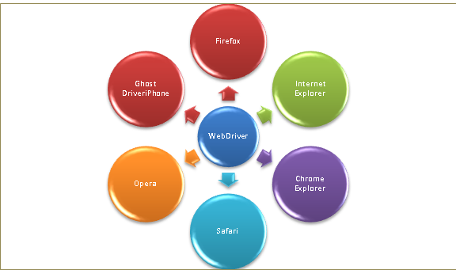
Cross browser testing
Making use of Third Party Browser Drivers to run webdriver code on different browsers.

Slide 39
Selenium Grid
With Selenium Grid you can create a network of connected test machines (also called nodes). This network of test machines is controlled by a Hub, using which you can run your tests on different connected nodes. Each node is basically a computer (even a virtual machine) with a combination of Operating system and Browsers. This enables us to create a network of test machines with varying combinations of Operating system and browsers. Using Selenium Grid you can run tests on a variety of Operating System and Browser combinations. You can connect to it with Selenium Remote by specifying the browser, browser version, and operating system you want. You specify these values through Selenium Remote’s Capabilities.
Step 1: Start a Hub (java -jar selenium-server-standalone-2.53.1.jar -role hub) – port:4444
Step 2: Register Nodes to the Hub (java -jar selenium-server-standalone-2.53.1.jar -role node -hub http://<hub IP>:4444/grid/register) – port:5555
Nodes are where your tests will run, and the hub is responsible for making sure your tests end up on the right one (e.g., the machine with the operating system and browser you specified in your test). Hub will try to find a machine in the Grid which matches the criterion and will run the test on that Machine. If there is no match, then hub returns an error. There should be only one hub in a Grid.
Usage:
When we want to run our tests against multiple browsers, the multiple versions of browsers and the browsers running on different operating system.
It is also used to reduce the time taken by the test suite to complete a test pass by running tests in parallel.

Slide 40
Selenium Grid
Step 3: Use RemoteWebDriver
You can use RemoteWebDriver the same way you would use WebDriver locally. The primary difference is that RemoteWebDriver needs to be configured so that it can run your tests on a separate machine.
There are two parts to RemoteWebDriver: a server(hub) and a client(node):
The RemoteWebDriver server is a component that listens on a port for various requests from a RemoteWebDriver Once it receives the requests, it forwards them to any of the following: Firefox Driver, IE Driver, or Chrome Driver, whichever is asked.
The language-binding client libraries that serve as a RemoteWebDriver. The client, as it used to when executing tests locally, translates your test script requests to JSON payload and sends them across to the RemoteWebDriver server using the JSON wire protocol.
String grid = "http://<hub IP>:4444/wd/hub";
DesiredCapabilities cap = DesiredCapabilities.firefox();
driver = new RemoteWebDriver(new URL(grid), cap);
driver.navigate().to(URL);

Slide 41
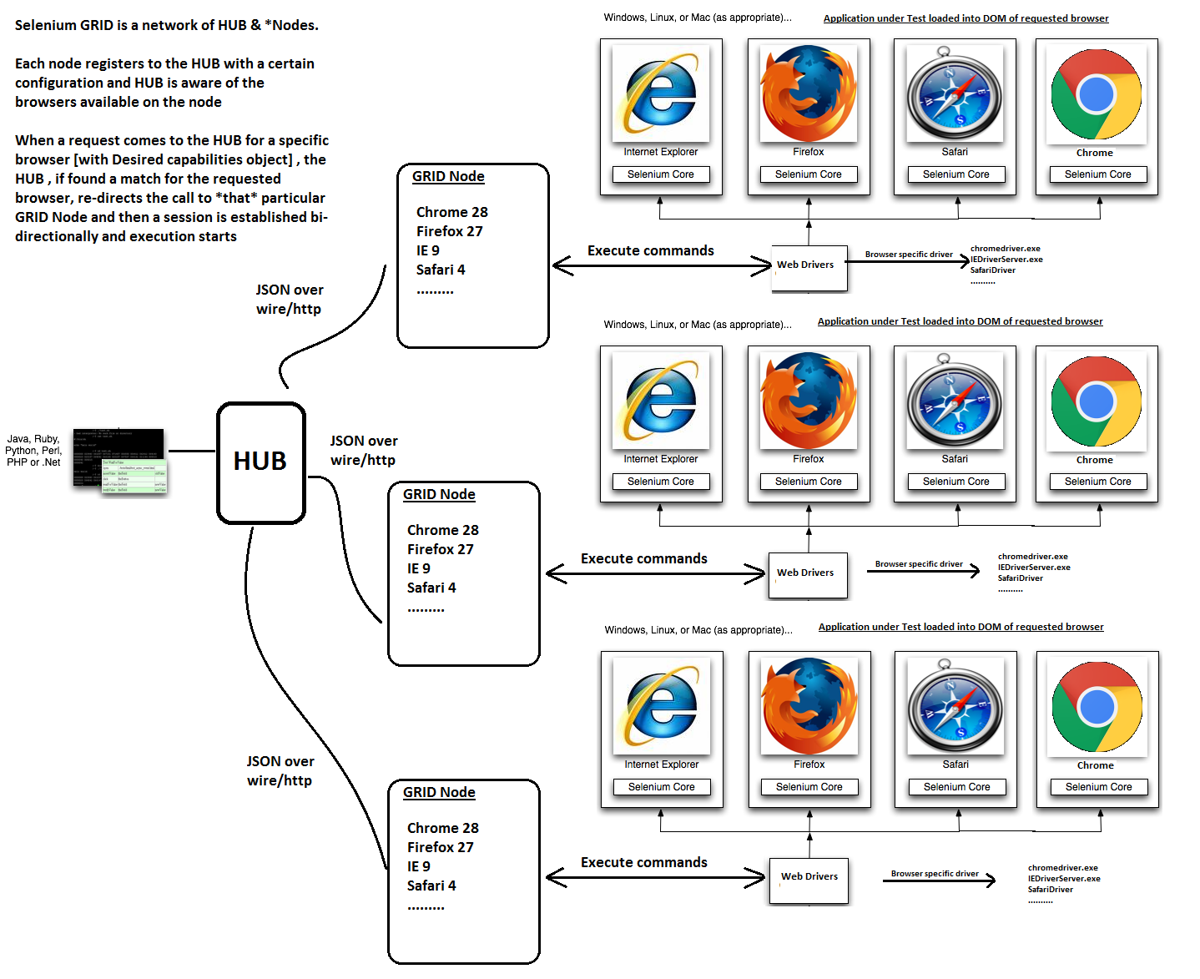
Selenium Grid

Slide 42
Selenium Grid
Useful parameters
-port
-browser browserName=,maxInstances=,version=,platform=
-maxSession (max. no. of browsers that an run in parallel on a node)
-timeout (node timeout, default=300s)
-Dwebdriver.ie.driver=
-Dwebdriver.chrome.driver=
…more
http://localhost:5555/selenium-server/driver?cmd=shutDownSeleniumServer
http://localhost:4444/lifecycle-manager?action=shutdown

Slide 43
Headless testing
HtmlUnitDriver
Fastest implementation of WebDriver
Uses a Java based “HtmlUnit” browser
htmlUnit browser uses Rhino JS engine (not used by any real browser ☹)
No screenshot support
Platform independent
PhantomJsDriver
Good JS support
Comes with the standard DOM API
Screenshot supported
Platform independent
Caution: The headless browsers have advanced enough to emulate any browser to a great extent, however, still not completely. Hence, it is not recommended to run all your tests in a headless browser. JavaScript is one area where you would want to be really careful before using a Headless browser. JavaScript are implemented differently by different browsers, including, headless browsers.
Xvfb (X virtual frame buffer)
For Unix environment with no display support; hence no browsers
Is an in-memory display server; enables you to run GUI applications without a display
Pre-requisites: $ apt-get install xvfb firefox
Start Xvfb: $ Xvfb :1 -screen 0 1024x768x24 &
Set the display: $ export DISPLAY=:1 or Guide firefox to use this virtual display
Test firefox: & firefox
Run the WebDriver test normally on a real browser

Slide 44
Junit
Is an unit testing framework; can be leveraged to do automation runs
Annotations:
@BeforeClass
@AfterClass
@Before
@After
@Test
@RunWith – to change the runner and not use the default JUnit runner
@Suite.SuiteClasses
A very simple XML report

Slide 45
TestNg
A testing framework inspired from JUnit and NUnit but is more powerful
Annotations:
@BeforeSuite
@AfterSuite
@BeforeTest
@AfterTest
@BeforeGroups
@AfterGroups
@BeforeClass
@AfterClass
@BeforeMethod
@AfterMethod
@Test
Tests can be grouped & prioritized
Ability to produce HTML reports & Logs
Parallel testing
Data-driven testing

Slide 46
JUnit vs. TestNg
Description | TestNG | JUnit 4
Test annotation | @Test | @Test
Executes before the first test method is invoked in the current class | @BeforeClass | @BeforeClass
Executes after all the test methods in the current class | @AfterClass | @AfterClass
Executes before each test method | @BeforeMethod | @Before
Executes after each test method | @AfterMethod | @After
annotation to ignore a test | @Test(enbale=false) | @ignore
annotation for exception | @Test(expectedExceptions = ArithmeticException.class) | @Test(expected = ArithmeticException.class)
timeout | @Test(timeout = 1000) | @Test(timeout = 1000)
Executes before all tests in the suite | @BeforeSuite | n/a
Executes after all tests in the suite | @AfterSuite | n/a
Executes before a test runs | @BeforeTest | n/a
Executes after a test runs | @AfterTest | n/a
Executes before the first test method is invoked that belongs to any of these groups is invoked | @BeforeGroups | n/a
run after the last test method that belongs to any of the groups here | @AfterGroups | n/a

